Slide 1


Fundamentals of RM
RM System and Process
Leadership in RM
Incident Investigation
RM Tools & Challenges
RM in Industry
People & Org.
Application and Perspectives
On Becoming a
Leader in Risk Management
ENGG404 - Lecture
Chapter 4.1: The Work Processes:
Incident Investigation,
Root Cause Analysis, and
Managing Corrective Actions
At Instructor’s discretion,
tee-up video:
“Elementary – Sherlock Holmes
and Dr. Watson at the Scene of
an Aircraft Crash”

Slide 2
ALE #1: Your Experience?
Please confer (pen-to-paper):
Have you ever been involved in a loss incident (with major or minor consequences) you later thought could have easily been prevented with a simple action?
Example:
Your cellphone drops into the sink from the pocket on your shirt.
Had you thought about this and placed it elsewhere, you wouldn’t be standing in line at TELUS / Rogers / Bell right now.
Share your experience with your colleague by answering these questions:
What was the situation and incident?
What would you have done?
What caused it?
What would you recommend to your classmate?
Chapter 4.1: II-RCA-MCA Work Processes
2
Notes:
2

Slide 3
Learning Outcomes:
Explain the need to investigate the scene and collect evidence.
Explain and apply the general II-RCA-MC Work Process to lead an Incident Investigation immediately after an incident happens, through the RCA and MCA work processes, and to conclude with a final check on the effectiveness of the process.
Chapter 4.1: II-RCA-MCA Work Processes
3
Notes:
3

Slide 4
Introduction:
Incidents do happen. If the causes leading to an incident are not addressed, the incident can potentially repeat itself.
Most organizations have systems in place for incident investigation and follow-up.
A framework for the overall work process for Incident Investigation (II), Root Cause Analysis and to Manage the (proposed) Corrective Actions.
Tools for analysis that we will see in the following lectures include Root Cause Analysis (RCA), Cause and Effect Models (C&E), and Manage Corrective Actions (MCA).
Chapter 4.1: II-RCA-MCA Work Processes
4
Notes:
4

Slide 5
Overall II-RCA-MA Work Process (general workflow):
Incident Happens
Incident Investigation: collect evidence relating to an event (i.e. the discovery and ascertainment of the facts of a loss incident).
Incident Investigation
Root Cause Analysis (RCA): determine the causes of an incident.
Root Cause Analysis
Manage Corrective Actions
Manage Corrective Actions: manages the corrective and preventative actions that address the latent causes identified in the RCA
Check Process Effectiveness
Chapter 4.1: II-RCA-MCA Work Processes
5
Notes:
5

Slide 6
Why should I learn how to …?
Q: Why should I learn how to investigate incidents, conduct a root cause analysis, and manage corrective actions?
A: It is an essential leadership process!
You will likely need it in your job: you will make decisions of technical and administrative nature in the future.
Because all incidents are preventable and we need to prevent them from recurring that is your role as a leader in risk management!
In your future role as a leader, you will recognize the effectiveness of applying these work processes in shaping the culture of your organization.
Therefore:
Investigation is source for learning (proactive).
Must determine the root causes to prevent recurrence (reactive).
Conduct investigations with a sense of urgency and a sense of commitment!
Chapter 4.1: II-RCA-MCA Work Processes
6
Notes:
6

Slide 7
ALE #2: When should an incident be investigated?
Please confer:
When should an incident be investigated? (MM-M/C)
When it is serious and must be reported to the government as required by law?
Whenever there is an incident with consequences (impacts on PEAP) even though it is not required to report to the government?
When there is some value or lesson to be learned from an incident even if there were no consequences?
Chapter 4.1: II-RCA-MCA Work Processes
7
Notes:
7

Slide 8
Incidents Investigated (or Managed) Using this Work Process:
When should you investigate an incident? (Leading organisations)
When it must be reported to the government as required by law.
Whenever there is an incident with consequences (impacts on PEAP).
When there is some value or lesson to be learned from an incident even if there were no consequences.
Can all incidents be investigated?
Most likely not all incidents can be investigated and managed, so how do you choose which incidents to investigate?
Investigations require resources.
Need to define “threshold criteria” in order to assign and use resources effectively!
Challenges:
Some organizations: may do nothing except the bare minimum as may be required by law.
Others have explicit criteria as to what requires an investigation.
Can only investigate when an incident is reported – strong culture that encourages reporting
Chapter 4.1: II-RCA-MCA Work Processes
8
Notes:
8
Immediately afterward
Severity or potential severity

Slide 9
Who Undertakes the Overall II-RCA-MCA Work Process?
Impartial leader, familiar with the processes, has credibility.
Investigation Team composition (not involved in the incident):
One or more experts in the incident investigation process and the root cause analysis process
One or more technical experts or specialists familiar with the work process being undertaken
Chapter 4.1: II-RCA-MCA Work Processes
9
Notes:
9

Slide 10

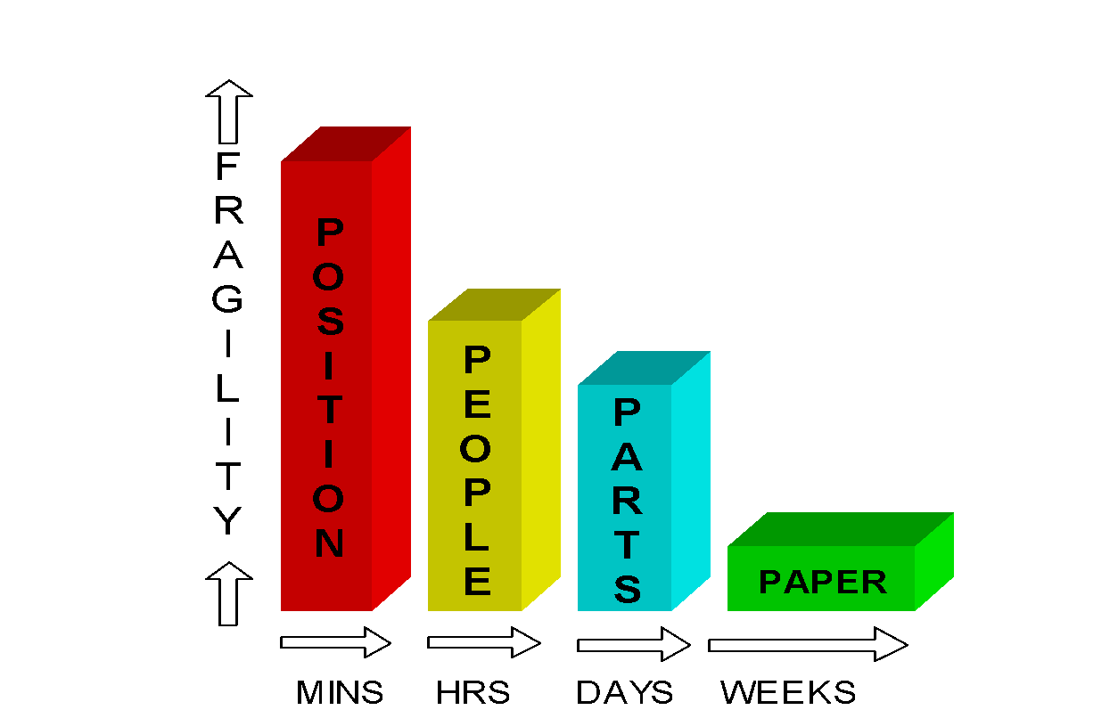
Evidence – You Need to Know What Happened and How:
When gathering evidence, time is most important!
Evidence can reveal what happened and how, but evidence can deteriorate, or degrade, or disappear with time.
Preservation of evidence:
Chapter 4.1: II-RCA-MCA Work Processes
10
Notes:
10
You now may be beginning to realize that unless your organization has some established practices in place the investigation will get off to a bad start. Until Syncrude established call out practices for investigators and “freeze evidence” protocols many investigation teams, formed days after the event, had a “cold trail” to follow. Consider the diagram above.
Evidence is captured in four areas known as the “four P’s”, each evidence type will disappear or become disturbed if not “frozen” or preserved. Position evidence is destroyed in minutes if the first people on the scene are unaware of preservation techniques, therefore it is important that the scene is taped off immediately after an incident and entry restricted. People talk amongst themselves and modify their observations accordingly or even forget “short term” memory information, therefore a simple statement sheet can be handed to them immediately after the incident to record their observations. Parts will be disturbed or thrown away, fracture surfaces contaminated. Computer generated data will not be printed and “second” data will be averaged out to “minute” data if practices are not established to dump data to hard copy. So it is important that an organization trains personnel in retention techniques and has established practices for evidence capture.

Slide 11
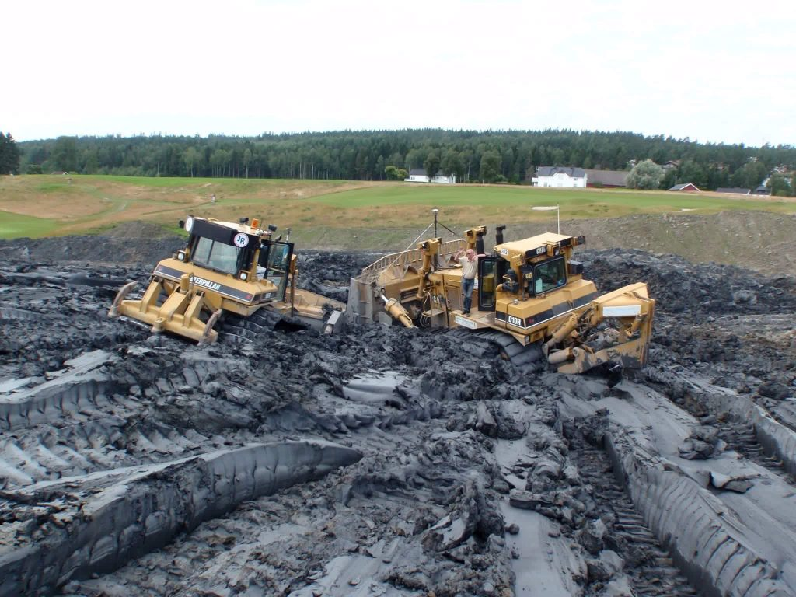
Example: The Caterpillar D12 Dozer Loss Incident
A Cat D12 dozer has gotten stuck in unexpected soft and wet clay.
The operator is all right, but the dozer requires repairs (down time).
A broken water pipe was found adjacent to the dozer. The dozer was within its planned route and the area had just been regraded.
Chapter 4.1: II-RCA-MCA Work Processes
11
Notes:
11

Slide 12
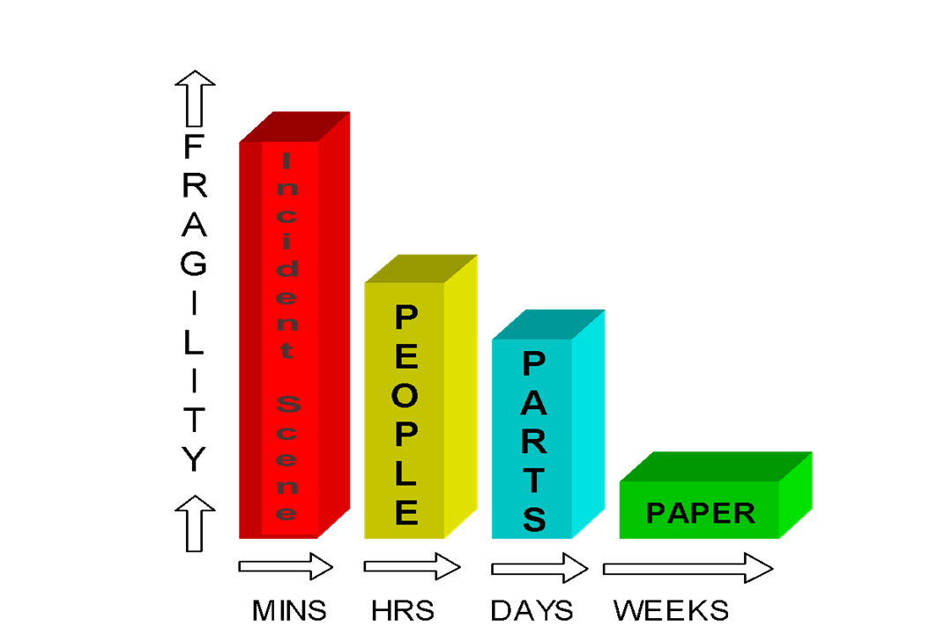
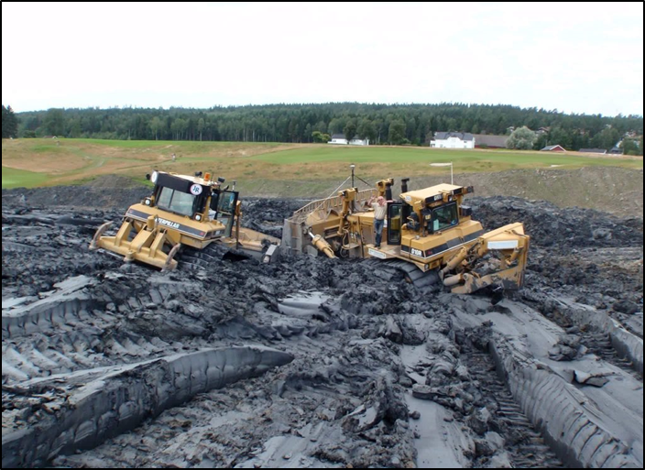
ALE #3: The Caterpillar D12 Dozer Loss Incident
Please confer (pen-to-paper, Open discussion):
Which specialists would you select for your investigation team? Why?
What evidence will you collect? Why?
Chapter 4.1: II-RCA-MCA Work Processes
12
Notes:
12

Slide 13
Example: The Caterpillar D12 Dozer Loss Incident
Specialists on the Loss Incident Investigation Team (and rationale):
ESRM II-RCA Expert
Guides the team through the work processes
Dozer Operator(s) NOT involved in the LI
Expertise in operations but NOT personally at stake
Supervisor of the Dozer Operator(s)
Has responsibility (and is accountable) for the dozer operators
Civil / Works Engineer
Expertise for the plot plans / drawings / underground services and surveys
Site / Project Manager
Has overall site/project responsibility, accountable for the loss incident
Dozer operator involved in the LI
as a witness / to be interviewed, but
NOT as a member of the team
Surveyor who marked the route and services
as a witness / to be interviewed, but
NOT as a member of the team
Why not these two individuals?
Chapter 4.1: II-RCA-MCA Work Processes
13
Notes:
13

Slide 14
Example: The Caterpillar D12 Dozer Loss Incident
Evidence that should be collected and in the priority order:
Detailed photographs of the scene
Locations of the flagging of the planned route
Locations of the flags marking the underground waterline
People interviews
Mechanical parts
FLRA's
Procedure for the planned route
Underground drawings
Weather bulletins
Why? …because the evidence can
“decay” or “degrade” as time passes:
The site and location flags can be disturbed.
People’s memories can fade or be influenced.
Parts?
FLRA’s first, then other documents are less likely to be tampered
Chapter 4.1: II-RCA-MCA Work Processes
14
Notes:
14

Slide 15
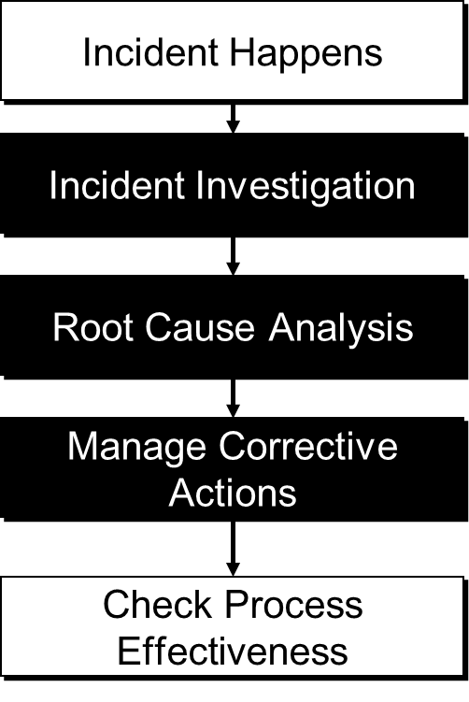
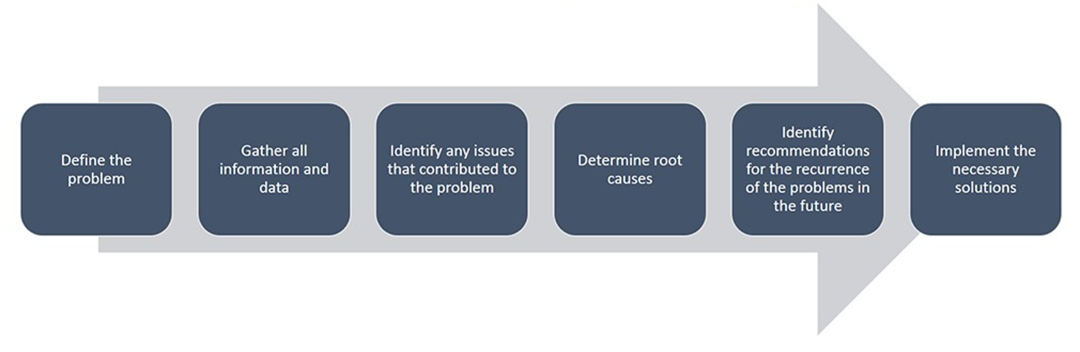
Summary and Key Lessons:
These processes will be effective only if
all components are complete, accurate,
and thorough.
Process is a learning experience for all.
Must commit to the process with people
and resources for investigations.
Many different models:
Chapter 4.1: II-RCA-MCA Work Processes
15
Notes:
15

Slide 16
Any questions?
Notes:
16

